Slide 1

FTA’s Best Practices
The Bionic Tigers - FTC 10464
modified from Ohio Kickoff presentation 2019
HOW TO KEEP YOUR ROBOT RUNNING ROUND AFTER ROUND

Slide 2
Common Causes of Robot Misbehavior
Electrical connections
Loose USB connections / damaged USB connectors
Battery power
Physical contact
Wi-Fi Issues
Game Controllers

Slide 3
Common Team Misconceptions
“There’s nothing we can do”
Even with more-or-less unavoidable issues like static electricity, there are preventative measures to reduce the impact
Teams that take responsibility for issues and think “what did we do wrong” or “what could we improve” will end up with the most robust robots
Underestimating the magnitude of physical contact
FTC is a full contact sport! Fragile robots will be at a disadvantage. Robustinate!

Slide 4
Fixing and Preventing problems

Slide 5
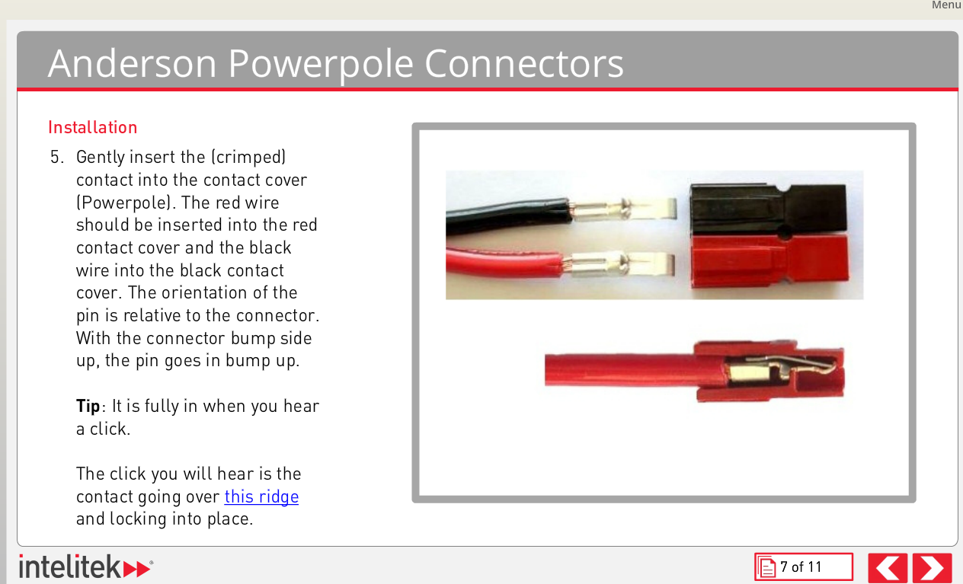
Electrical Connections
Before each round or as often as is feasible, double check all of the electrical connections
Battery connector
USB cables
CORE Module Power Poles
Power Switch
Design cable holders to reinforce USB connections and prevent wiggling or strain
It may help to utilize rubber bands, zip ties or other materials to physically pull the cable into the hub

Slide 6
Electrical Connections
Phase out Tamiya connectors in favor of Anderson Powerpoles
Tamiya connectors the point of failure numerous times – the connection gradually becomes loose over time
Intelitek has a nice tutorial about how to attach Anderson Power Pole connectors
Be aware that replacing the cable on the PDM will void the warranty – consider using an adapter
Avoid excessively long cables
Especially motor/servo controllers

Slide 7
USB Disconnects
A common cause of robot issues is USB connections
After many disconnects and reconnects, USB connectors bend or become loose
Robot motion can wiggle cables and cause temporary or permanent disconnects
Impacts with robots, walls, or game elements can temporarily disconnect the USB cables, and the interruption can cause the robot to stop responding
Solutions:
Use right-angle cables, fasten to the robot i.e. with rubber bands
Carry several spare cables (cheap from Monoprice!)
When available, use ADB over WiFi to avoid extra connects and disconnects
Updates to FTC SDK have improved reliability of USB communications and improved reactions to ESD events.

Slide 8
Battery Power
Low robot batteries can lead to sluggish movement, or failure to move at all
It’s always a good idea to keep your batteries as charged as possible, though this can be difficult with tight match schedules
Keep one or more spare, fully charged batteries on hand
Remember – if you’ve just done 10 test runs of your robot on a practice field right before your next match, your batteries are probably going to be low!
There may be issues with trying to configure the Robot Controller if the battery is below a certain voltage
Make sure both of your phones are both charged as well – invest in some higher amperage chargers

Slide 9
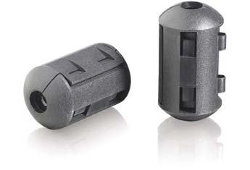
More Tips
Don’t place Phone in the middle of your robot
Place it up high and out of the way of metal
Make sure screen with Robot Controller app is visible
Reduce wireless noise coupled through USB cables– try a Ferrite Choke
Can buy for a few bucks at Radio Shack or other, not out of business retailers
Snaps on to the start and end USB cable
Also look at USB Surge protectors to protect from static

Slide 10
Static Electricity
Be very conscious of using omniwheels–generates charge rapidly
Be smart when using plexiglass – great for isolating electronics from the metal frame, but large quantities collects charge
Avoid spinning plastic devices in general, e.g. the infamous zip tie brush
Basically just attaching a Van De Graff generator to your robot…
Avoid extra-long USB cables, and avoid wrapping around the frame
Don’t run USB cables next to power cables
Use quality, shielded cables
Isolate electronics from the metal frame
Prevents static from contact with the frame from entering delicate electronics
Use plenty of Ferrite Chokes!
Be especially careful when using legacy motor and servo controllers – prone to the same lockups we’ve seen with the past tech

Slide 11
Physical Contact
Ensure that your robot is not easily damaged by impacts with other robots
Consider that, based on the game, there can be various robot arms occupying the airspace around your bot
Minimize the possibility of wires being ensnared by other bots
Consider a screen protector for phone

Slide 12
Wi-Fi Interference
Make sure your phones have the cell radios disabled
Turn off bluetooth
Encourage your friends and family to avoid using mobile WiFi hotspots at the tournament
If you bring a router for some odd reason, make sure the signal does not leak into the tournament area
If many teams / robots are trying to connect to each other simultaneously, it can be difficult to pair. Try pairing in an area isolated from other robots

Slide 13
Game Controllers
Every once in a while, a game controller actually does stop working correctly – bring spares
Many other times, the real problem lies elsewhere
Latency – Heavy Wi-Fi traffic
Mis-mapped controller 1 v 2 (Start + A = 1, Start + B = 2)
Legacy controllers (Logitech Dual Action): Start + X/Y to map
ZTE Speed phones are known to occasionally stop communicating with gamepads – only solution is restarting the phone
The Moto G may have issues powering two controllers through a hub – can use battery hub

Slide 14
Other Good Practices

Slide 15
Robot Construction
Use the latest electronics
The Modern Robotics modules are generally more robust than the older Hi-Technic motor and servo controllers
Label your electronics modules by their serial numbers for easy troubleshooting
Make your power switch incredibly obvious to spot
Colorful arrows, flashing LEDs, raised section of the robot, etc…
However, be careful to reduce the chance of another robot or a falling game element accidentally pressing the switch (this has happened several times)
If you bury your power switch inside your robot, the inspector is going to give you a dirty look in inspections…. And then make you move it.
Manage cables and wires to prevent them from being hooked by another bot
Avoid heavy use of LEGO parts (sensors are OK)
LEGO parts are much more fragile.
Compliment with Tetrix parts for strength
Make sure your Robot Controller screen is visible
But don’t expose it to unnecessary danger of impact from other robots

Slide 16
Robot Construction
Try to electrically isolate the modern robotics modules from metal or loose wires as much as possible
Static conducted through the frame may find its way directly to the modules, or through wires
It is a bad idea to wrap ANY wires around the robot frame – keep them only as long as they need to be, and try to insulate from the frame
Ideally, your cables should be off frame (perhaps in a plastic cable sleeve), and the modules should be mounted against an insulator such as wood or a wood substrate, or PVC type-A
Avoid mounting on plexiglass or plastic sheets, as they are charge sponges
Feasibility may vary by game challenge, but try to avoid charge-generating robot attachments such as plastic zip tie sweepers mounted on a metal axle
Omni wheels can also contribute to this problem if used in large quantities

Slide 17
Robot Programming
Make use of the telemetry data return to debug potential issues
If you drop in replace one of the Core modules, you need to redo the configuration
Each piece of hardware is identified by its serial number, which is checked by the config file. Different serial number = won’t work with different hardware
Hardware swap feature. Makes it easy to replace electronics.
Keep checking the FIRST GitHub and Technology forum for new SDK releases – the latest alpha or beta builds are usually made to solve the most commonly reported issues
You should try and make it as easy as possible to test new SDKs while also ensuring that the stable version is maintained in case of unexpected failure, for example using version control, multiple folders / laptops, or multiple robot controllers with a different version on each

Slide 18
Robot Programming
If using a linear op mode (sequential commands), ensure that any loops are interruptible. This can be done by inserting a check for Opmode isActive in the loop conditions (quit loop if opmode not active)
Also ensure that waiting periods use sleep, which is interruptible.
For robots that use high draw or many motors, especially if many motors will be running simultaneously – be considerate of the method by which motor controllers set the motor power
Speed target: will crank up voltage to try and hit a specified speed when resistance is encountered (e.g. wall, slope, other robots…)
Can lead to a current spike, and thus a voltage drop, which can brownout the Modern Robotics modules and cause the robot to drop connection
Voltage target: does not change load even if motor encounters resistance

Slide 19
Be Prepared
If you can afford it, get a few extras of crucial parts, including:
Tetrix batteries
A robot controller
A spare gamepad
Spare USB cables (both mini connectors for the modules to the core power distribution module, and the mini-micro chain for the robot controller)
A spare unpowered USB hub, if you use two gamepads
Modern robotics modules, especially the core power distribution module
Even if you never need your spares, you might be able to make the difference for another team having a really bad day

Slide 20
Extra Precautions
Between matches, as much as possible, try to:
Make sure the robot has a fresh Tetrix battery
Restart your phones (ESPECIALLY ZTE Speeds!) and pair them to the RC before arriving at the field
Can mitigate gamepad connection problems
If you are really paranoid about static and it’s extra dry, try bringing dryer sheets and giving your robot a wipedown
If only slightly paranoid, touch metal on the robot to the metal of the field walls to discharge / neutralize the charge on the robot before the match

Slide 21
WHEN IN DOUBT….
Ask a veteran team!
Most experienced teams are more than happy to help out
Less dead robots means more fun for everyone
Use FIRST’s resources
https://www.firstinspires.org/resource-library/ftc/technology-information-and-resources
https://www.firstinspires.org/resource-library/ftc/robot-building-resources
Check the forums and ask questions
http://ftcforum.usfirst.org/forumdisplay.php?156-FTC-Technology
Check the GitHub documentation and tutorials
https://github.com/ftctechnh/ftc_app/tree/master/doc/tutorial
https://github.com/ftctechnh/ftc_app/wiki

Slide 22
Dealing with Static
Be sure to check the latest rules and FAQ posts to determine legal parts! E.g., dragging chains/wires and copper tape have been outlawed due to creating more problems for teams without the preventative measures.
See Tom Eng’s stickied post on the FTC Technology Forum:
http://ftcforum.usfirst.org/showthread.php?6128-Electro-Static-Discharge-Mitigation&s=d18780fbd3b1e75aea2ae4a6faf6fe24

Slide 23
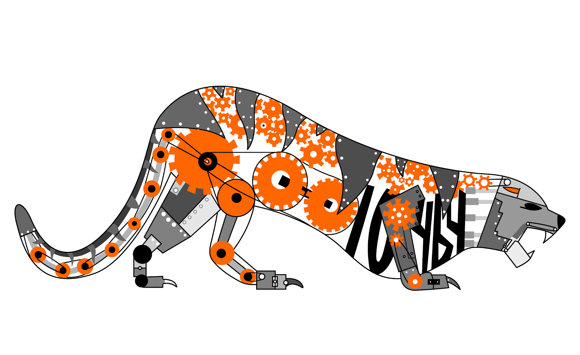
Credits
This lesson was written by The Bionic Tigers 10464 for FTCTutorials.com
Original presentation from Ohio FTA at Ohio Kickoff 2019
You can contact the author at
More lessons for FIRST Tech Challenge are available at www.FTCtutorials.com
Website:
http://lovelandrobotics.com/team10464
Twitter:
@BionicTigersFTC
Email:
BionicTigers10464@gmail.com
This work is licensed under a
Creative Commons Attribution-NonCommercial-ShareAlike 4.0 International License.

